Slide 1
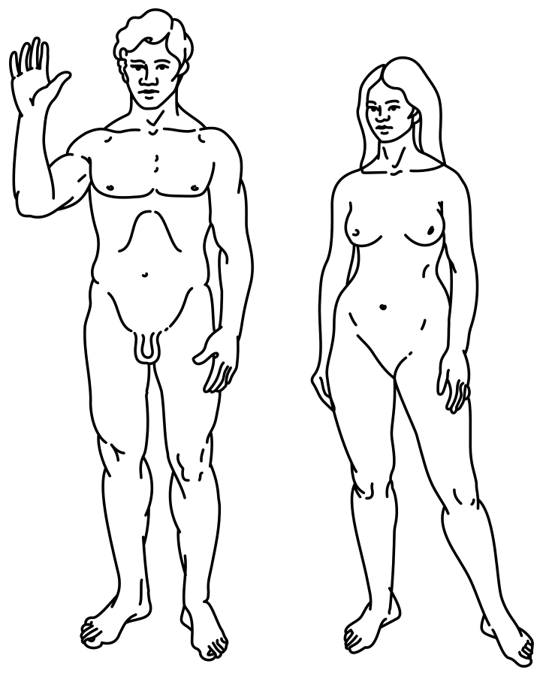

Human Sexual Anatomy and Physiology
[Professor Name]
[Class Section Number]
Notes:
Classroom Recommendations: This PowerPoint is designed to present this information over the course of one (75-minute) class. This information could be expanded to cover two days, if you add some activities from the Noba Instructor Manual or if you extend the amount of time in the current activities.
Overview: This is one of two modules on Human Sexuality, and it covers sexual anatomy and physiology. It’s natural to be curious about anatomy and physiology. Being knowledgeable about anatomy and physiology increases our potential for pleasure, physical and psychological health, and life satisfaction. Beyond personal curiosity, thoughtful discussions about anatomy and physiology with sexual partners reduces the potential for miscommunication, unintended pregnancies, sexually transmitted infections, and sexual dysfunctions. Lastly, and most importantly, an appreciation of both the biological and psychological motivating forces behind sexual curiosity, desire, and the capacities of our brains can enhance the health of relationships.
Technical Note: These slides may contain simple click animation so that you can focus students’ attention on a particular question, a selection of text, or an image and not have them be distracted by reading ahead. You can either preview the sequence of animation by going through the slides in slideshow view, visiting the animations tab, or reviewing the slide notes. In the notes you will see a cue - (Click) – that corresponds to each animation.
You may also find hyperlinks to outside videos at various places in the slides. These hyperlinks are embedded in text and indicated by color and in the notes section.

Slide 2

Warmup Activity
Notes:
This purpose of this slide is to present an activity to introduce the topic of Human Sexual Anatomy and Physiology.
This activity is intended to break the ice on talking about sex and using language involved with sexual anatomy. It uses a metaphor and can be explored in-depth, and can be tied to other introductory messages such as the importance of studying sex (and the psychological dimensions of sex) scientifically.
Time: 5 minutes
Materials: none
Instructions: Have students cluster in small groups and discuss the following prompt:
Imagine a world in which talking about cars was taboo. Parents felt embarrassed to bring up the topic and created fake words like “Fu-Fu” to call cars to their young children. Adults knew that cars are a fact of life, but avoided taking their children to gas stations or mechanics and rarely talked about cars in polite company. When children became teenagers, they had a natural curiosity about driving, but mostly had to sneak a quick drive when their parents weren’t around. Discuss the various problems you see with this world. What might happen? Make a connection to how this is similar to the ways in which we treat sex, and words related to sexual anatomy.
Debrief Questions:
In the imaginary scenario, what problems did you see connected with the idea that people were not able to openly discuss cars?
How do you see the metaphor of cars as being related to the way that we treat sex in modern society? What problems arise because of the way we treat sex as a taboo topic?
How might you change this?

Slide 3
Overview
Why Sexual Anatomy is being taught in psychology:
Masters & Johnson
Pleasure? Or Reproduction?
Sexual Anatomy and Physiology
Female
Male
The Sexual Response Cycle
Consequences of Sexual behavior?
Pregnancy
Birth Control
STIs
Sexual Dysfunctions & Treatments
Conclusion
Notes:
The purpose of this slide is to provide students with an overview of the material that will be covered during the lecture.
Technical Note: These slides may contain simple click animation so that you can focus students’ attention on a particular question, a selection of text, or an image and not have them be distracted by reading ahead. You can either preview the sequence of animation by going through the slides in slideshow view, visiting the animations tab, or reviewing the slide notes. In the notes you will see a cue - (Click) – that corresponds to each animation.

Slide 4
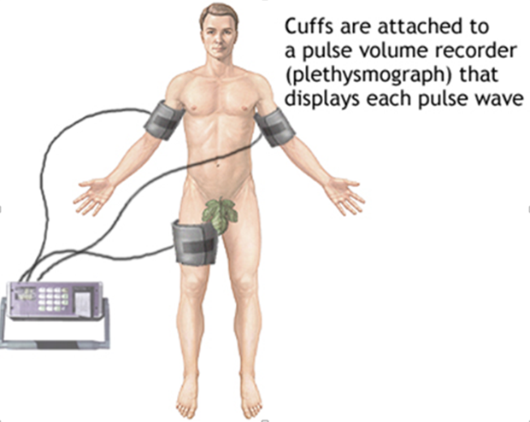
Masters & Johnson
Notes:
The purpose of the this slide is to discuss researchers Masters and Johnson.
Masters and Johnson are colorful figures, and widely regarded as pioneers in the study of sex. They used physiological methods to empirically investigate sexual function and behavior and were interested in de-mystifying this topic through science. Some students may be familiar with them because of the television show “Masters of Sex”. This slide is an opportunity to engage students in thinking about how sex and science interface.
Consider possible small or large group discussions:
What can science tell us about sex that we cannot learn in other ways?
Are there aspects of sex and sexual behavior that you believe should not or cannot be studied? What is your rationale?
What are the potential benefits of studying sexual anatomy and function scientifically?
What are some of the obstacles to effectively studying these topics scientifically?
Note on Image: Masters and Johnson made some advances in the technique of plethysmography which is why this image was chosen.

Slide 5
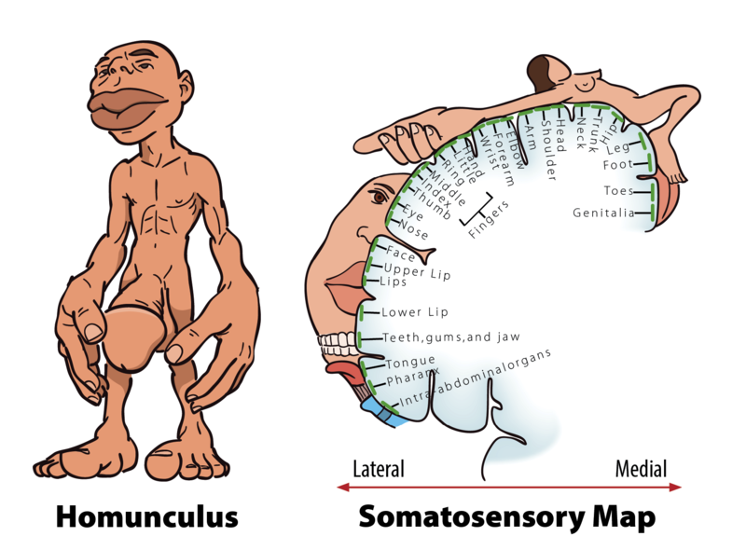
Sex: Pleasure or Reproduction?
Notes:
The purpose of this slide is to discuss the purpose of sex.
Here, you can discuss the aspects of sexual behavior: pleasure and reproduction. This is a brief stop in the introduction: it is an opportunity to point out that sexual function is, in part, about reproduction; but that sexual behavior is also about producing physical and psychological pleasure, often in the absence of any intention to reproduce.

Slide 6
Overview
Why Sexual Anatomy is being taught in psychology:
Sexual Anatomy and Physiology
Female
Male
The Sexual Response Cycle
Consequences of Sexual behavior?
Pregnancy
Birth Control
STIs
Sexual Dysfunctions & Treatments
Conclusion
Notes:
The purpose of this slide is to provide students with an overview of the material that will be covered during the lecture.
Technical Note: These slides may contain simple click animation so that you can focus students’ attention on a particular question, a selection of text, or an image and not have them be distracted by reading ahead. You can either preview the sequence of animation by going through the slides in slideshow view, visiting the animations tab, or reviewing the slide notes. In the notes you will see a cue - (Click) – that corresponds to each animation.

Slide 7
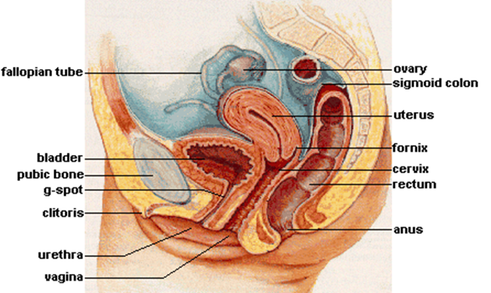
Activity: Female Anatomy
Labia
Clitoris
Vagina
Uterus
Ovaries
Fallopian Tubes
Notes:
The purpose of this slide is to introduce the topic of on the female anatomy (followed by a slide on male anatomy).
Here, instructors highlight three core concepts related to human sexual anatomy. These are often confusing to students because they include a number of difficult vocabulary words. You might consider focusing especially on core anatomy and its function, with additional consideration of more trivial topics confined to homework, extra credit, or similar study as time allows.
Female and male sexual anatomy can be taught using an activity:
Female Sexual Anatomy = Female anatomy can seem confusing or mysterious. Typically, it is divided into external and internal organs. The primary functions of the internal sex organs of the female are to store, transport, and keep ovum cells (eggs) healthy; and produce hormones.
Male Sexual Anatomy = The most prominent external sex organ for the male is the penis. The penis’s main functions are initiating orgasm, and transporting semen and urine from the body. On average, a flaccid penis is about three and a half inches in length, whereas an erect penis is about five inches (Veale et al., 2015; Wessells, Lue & McAninch, 1996).
Because it is here, with male and female sexual anatomy, that students are most likely to be A) embarrassed, B) confused, and C) overwhelmed by the vocabulary, feel free to take questions and answers. You might consider having students submit questions (anonymous or otherwise) about anatomy the week before this class lecture. This would give you an opportunity to sort the questions and answer the most common or interesting ones in this part of the lecture.
This activity is an opportunity for students to reflect on their own baseline knowledge of sexual anatomy and to learn new terms.
Time: 5 minutes
Materials: Blank paper on which to draw and a writing implement.
Instructions: Have students retrieve a blank sheet of paper and something to draw with (i.e., pen or pencil). Ask them to draw, from memory or imagination, male and female sexual anatomy. Have them label the various parts and write a word or two suggestive of the function of each. Direct them to include as many of the terms as are depicted on the slide. Reassure them that this is not an assessment of artistic ability but an opportunity to get a gauge on how accurately and completely they understand the anatomy of each sex.
Note the image of female and (male on the next slide) anatomy appears on Click so as to aid you in the administration of this activity.
Possible Debrief Questions:
Was the anatomy of one or the other sex more difficult to remember and draw? If so, what are some possible reasons for this? What have you learned from this activity? What will you do with that lesson?
Why might it be important to be able to label anatomy accurately and understand the function of each? What might be dangers in not being able to do so?

Slide 8
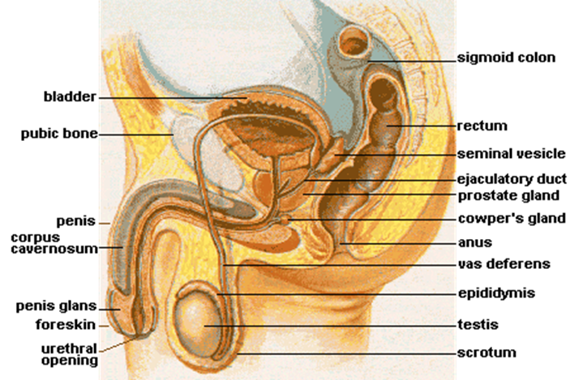
Activity: Male Anatomy
Testes
Penis
Vas Deferens
Seminal Vesicle
Scrotum
Urethra
Notes:
Please see the instructions for this activity on the previous slide.

Slide 9
Overview
Why Sexual Anatomy is being taught in psychology:
Sexual Anatomy and Physiology
The Sexual Response Cycle
Consequences of Sexual behavior?
Pregnancy
Birth Control
STIs
Sexual Dysfunctions & Treatments
Conclusion
Notes:
The purpose of this slide is to provide students with an overview of the material that will be covered during the lecture.
Technical Note: These slides may contain simple click animation so that you can focus students’ attention on a particular question, a selection of text, or an image and not have them be distracted by reading ahead. You can either preview the sequence of animation by going through the slides in slideshow view, visiting the animations tab, or reviewing the slide notes. In the notes you will see a cue - (Click) – that corresponds to each animation.

Slide 10
The Sexual Response Cycle
Emotional Intimacy
Sexual Neutrality
Sexual Stimuli
Sexual Desire and Arousal
Emotional and Physical Satisfation
Sexual Arousal
Notes:
The purpose of this slide is to discuss the Human Sexual Response Cycle
The SRC is composed of four phases:
• Excitement: Activation of the sympathetic branch of the autonomic nervous system defines the excitement phase; heart rate and breathing accelerates, along with increased blood flow to the penis, vaginal walls, clitoris, and nipples.
• Plateau: Blood flow, heart rate, and breathing intensify during the plateau phase. During this phase, often referred to as “foreplay,” females experience an orgasmic platform—the outer third of the vaginal walls tightening—and males experience a release of pre-seminal fluid containing healthy sperm cells. This early release of fluid makes penile withdrawal a relatively ineffective form of birth control.
• Orgasm: The shortest but most pleasurable phase is the orgasm phase. After reaching its climax, neuromuscular tension is released and the hormone oxytocin floods the bloodstream—facilitating emotional bonding. Although the rhythmic muscular contractions of an orgasm are temporally associated with ejaculation, this association is not necessary because orgasm and ejaculation are two separate physiological processes.
• Resolution: The body returns to a pre-aroused state in the resolution phase. Males enter a refractory period of being unresponsive to sexual stimuli. The length of this period depends on age, frequency of recent sexual relations, level of intimacy with a partner, and novelty. Because females do not have a refractory period, they have a greater potential—physiologically—of having multiple orgasms.

Slide 11
Overview
Why Sexual Anatomy is being taught in psychology:
Sexual Anatomy and Physiology
The Sexual Response Cycle
Consequences of Sexual behavior?
Pregnancy
Birth Control
STIs
Sexual Dysfunctions & Treatments
Conclusion
Notes:
The purpose of this slide is to provide students with an overview of the material that will be covered during the lecture.
Technical Note: These slides may contain simple click animation so that you can focus students’ attention on a particular question, a selection of text, or an image and not have them be distracted by reading ahead. You can either preview the sequence of animation by going through the slides in slideshow view, visiting the animations tab, or reviewing the slide notes. In the notes you will see a cue - (Click) – that corresponds to each animation.

Slide 12
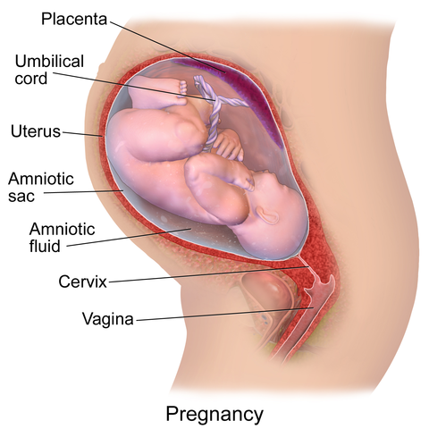
Pregnancy
Notes:
The purpose of this slide is to discuss the consequences of sexual behavior.
Sexual behavior, ranging from masturbation to intercourse, can have consequences. Many of these are psychological such as feelings (intimacy, regret, etc). Some are physical. Because this module emphasizes the physiological aspects of sex, we focus more heavily on the physical consequences here. Note that physical consequences are also frequently accompanied by psychological shifts (eg. Pregnancy causes dramatic shifts in identity). Although the module does not explicitly frame pregnancy, birth control, and Sextually Transmitted Infections (STIs) as “consequences of sexual behavior” it may be thematically helpful to cluster these topics in this way.
Specific phases of pregnancy are discussed on the next slide.

Slide 13
Pregnancy
Stage/Weeks | Trimester | Development
Blastocyst then Zygote | 1 (weeks 1-13) | Implanting in the uterus Early cell division
Embryo | Trimester 2 (weeks 14-26) | Hair Organs begin function Sex organs develop Age of viability (26th week)
Fetus | Trimester 3 (weeks 27-39) | Central Nervous System Eyes Teeth
Notes:
The purpose of this slide is to continue the discussion on Pregnancy.
Pregnancy is the gestation of a new human. It begins at conception, when a sperm fertilizes an ovum. It continues for 39-40 weeks and is divided into 13-week trimesters; each is associated with specific developmental milestones.

Slide 14
Birth Control
Method | Effectiveness
“The Pill” | 92%
Condom (male) | 85%
Vasectomy | 99.85%
Fertility Awareness Method | 75%
Withdrawal | 73%
Notes:
The purpose of this slide is to discuss birth control methods.
Since antiquity, people have attempted to control the moment and rate at which they become pregnant and reproduce. Traditionally, this has been accomplished by refraining from sex during high-fertility times during a woman’s menstrual cycle, through withdrawal (male orgasm outside of the vagina), or through the administration of herbal remedies thought to block conception. In modern times, a number of more effective contraceptives have been invented such as condoms (latex acting as a physical barrier that prevents sperm from coming into contact with ova) and “the pill” (often a combination of estrogen and progesterone). There are a number of important issues related to birth control:
o No method is 100% effective if people engage in sexual intercourse
o Most of the methods do not protect against the transmission of sexually transmitted infections (barrier methods are the most effective in this regard)
o Birth control is historically significant in that it is associated with female empowerment (women who control pregnancy are more likely to be able to choose their parenting burdens and balance parenting with other potential goals such as work outside the home)
o Birth control is politically and morally controversial. Many people object to birth control methods as interfering with “nature.” In particular, there are strong objections to forms of birth control that interfere with the viability of an already fertilized ovum. This is because many people consider “life to begin at conception.”

Slide 15
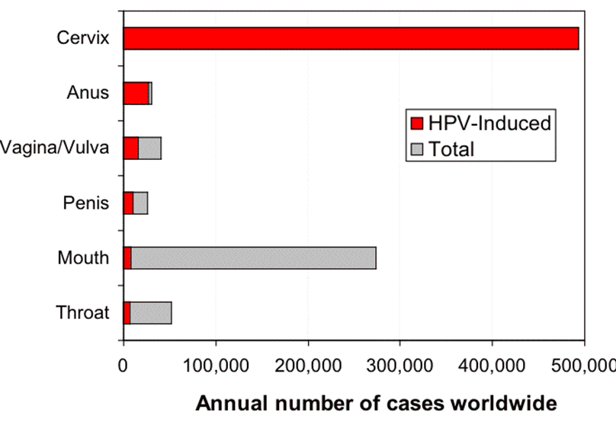
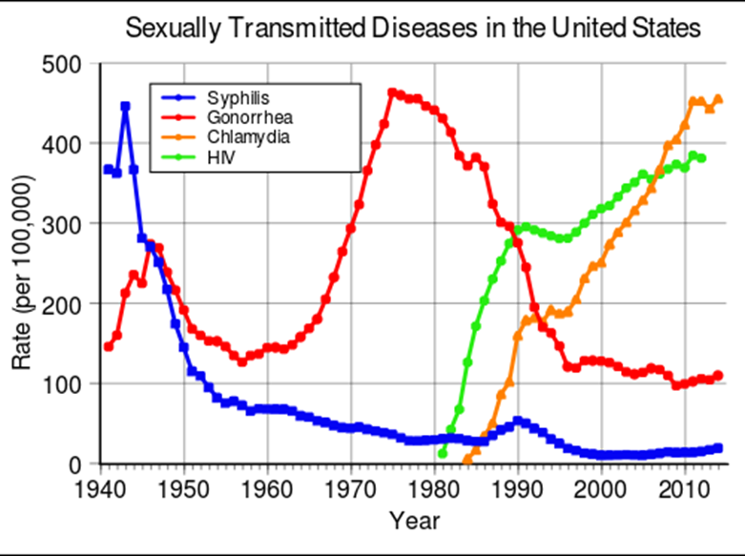
STIs
Notes:
The purpose of this slide to present a discussion on Sexually Transmitted Infections or STIs.
Sexually Transmitted Infections (formerly called “sexually transmitted diseases”) are the result of multiple sexual partners. To give an idea of indirect exposure through sexual intercourse, imagine Person X has had 5 sexual partners, and they have each had 5 sexual partners. But those people have also had sexual partners, and so on. Counting to six degrees person X has indirectly been exposed to 19, 530 people. If person X had 10 partners, and her partners had 10 partners the exposure would jump to more than 1 million one hundred thousand. The result of all this exposure is the risk of STIs.
STIs may be of particular concern to traditionally aged high school and college aged students. This is, in part, because of increasing attention to HPV (a virus linked to cervical cancer). According to the CDC, about 1 in 5 people between 18-59 is a carrier of the high-risk strand of HPV (in a 2014 study: 25% of all men in the US and 20% of all women).
HIV, the virus that causes AIDS, is also noteworthy in that it emerged in the 1980s and has reached global epidemic proportions since that time. Although, in the US, almost 400 out of every 100,000 people has HIV—and 36.7 million people have been infected worldwide—it is also a case study of treatment. Research has examined the effectiveness of education programs, circumcising males, and treating HIV to dramatically extend the lifespan. See: http://www.who.int/hiv/pub/guidelines/sex_worker/en/
(Click): Sexually Transmitted Diseases in the United States

Slide 16
Overview
Why Sexual Anatomy is being taught in psychology:
Sexual Anatomy and Physiology
The Sexual Response Cycle
Consequences of Sexual behavior?
Sexual Dysfunctions & Treatments
Conclusion
Notes:
The purpose of this slide is to provide students with an overview of the material that will be covered during the lecture.
Technical Note: These slides may contain simple click animation so that you can focus students’ attention on a particular question, a selection of text, or an image and not have them be distracted by reading ahead. You can either preview the sequence of animation by going through the slides in slideshow view, visiting the animations tab, or reviewing the slide notes. In the notes you will see a cue - (Click) – that corresponds to each animation.

Slide 17
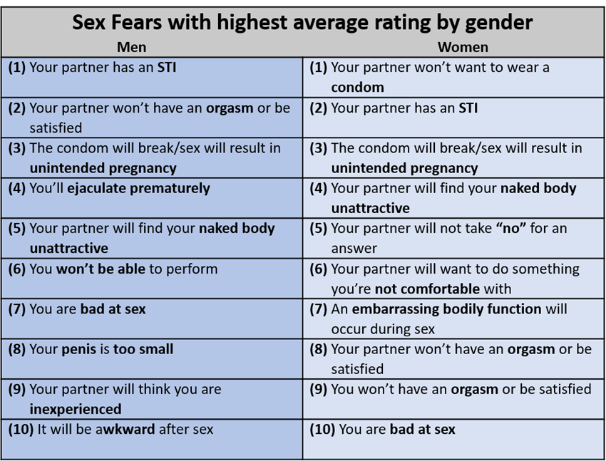
Sexual Dysfunction: Common Fears
Notes:
The purpose of this slide is to introduce the sexual dysfunctions topic and the common fears.
Here you can exhibit the list of common male and female fears.
The next slide has an activity associated with this slide – it gives a breakdown of 4 types of common fears that can be derived from the table on this slide. You can have students get into small groups and decide which of the 4 are most concerning for men versus women, the slide is animated with a table that presents the answers that you can display after the activity is over to engage in meaningful discussion.

Slide 18
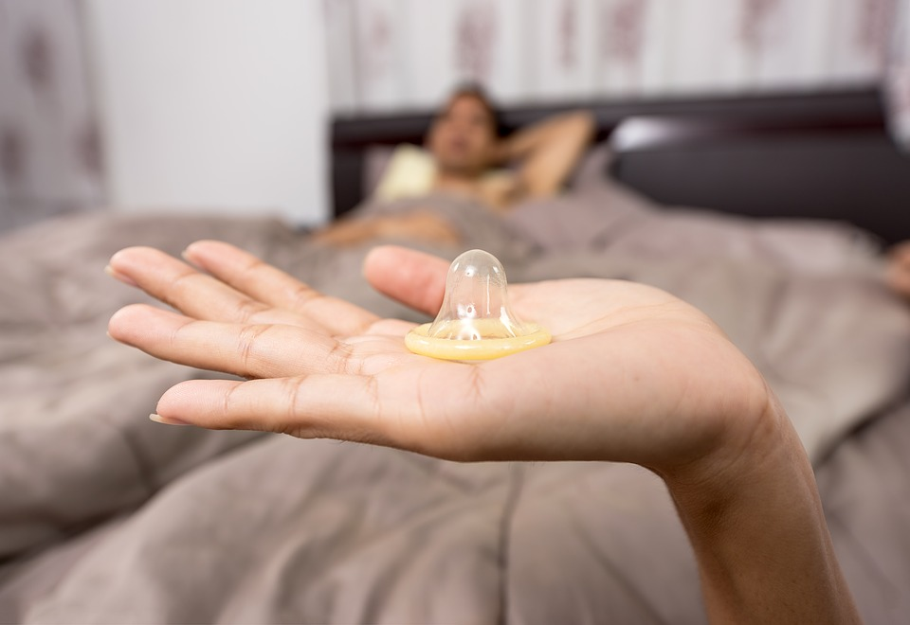
Sexual Dysfunction: Common Fears
Categories:
Performance
Body Image
Unintended Consequences
Consent
 | Body | Performance | Consequences | Consent
Men | 2 | 6 | 2 | 0
Women | 2 | 3 | 3 | 2
Notes:
This slide presents an activity on the Common Fears and the difference between men and women.
Note that these fears divide into identifiable categories: Some are related to 1) performance, while others are related to 2) anatomy or body image concerns, 3) Pregnancy or infection, and 4) being forced to do something you are unwilling or uncomfortable doing. You may consider having students break into small groups and categorizing each of these fears for the male and then—separately—for the female fears. Debrief questions:
Are men and women afraid of the same things? How are they alike or different in their fears?
Are the common fears equally distributed across the 4 categories? What does this tell you?
If a friend came to you and voiced one of these fears, how would you respond?
You can Click to reveal the table that presents the answers.
Note: Although the categorization described above is somewhat subjective, you can see clear differences between the concerns of males and females. Here is one possible way to categorize these fears. As can be seen, men are largely concerned with performance, while women harbor many concerns, including a unique set of concerns around consent.

Slide 19

Sexual Dysfunction: Common Dysfunctions - Male
According to the DSM, there are four male-specific dysfunctions:
Delayed Ejaculation
Erectile Disorder (ED)
Male Hypoactive Sexual Desire Disorder
Premature Ejaculation (PE)
Notes:
The purpose of this slide is continue the discussion on Sexual Dysfunction and discuss Common Dysfunctions.
Common dysfunctions-Sexual dysfunctions can affect both men and women, and people of all ages. There are a variety of causes for these, including purely psychological ones.
According to the DSM, there are four male-specific dysfunctions:
(Click): delayed ejaculation
(Click): erectile disorder (ED)
(Click): male hypoactive sexual desire disorder
(Click): premature ejaculation (PE)
In this section, you can introduce these disorders and discuss their treatments.

Slide 20

Sexual Dysfunction: Common Dysfunctions - Female
According to the DSM, these are three female-specific dysfunctions:
Female Orgasmic Disorder
Female Sexual Interest/Arousal Disorder (FSIAD)
Genito-pelvic Pain/Penetration Disorder
Notes:
The purpose of this slide is continue the discussion on Sexual Dysfunction and discuss Common Dysfunctions.
Common dysfunctions-Sexual dysfunctions can affect both men and women, and people of all ages. There are a variety of causes for these, including purely psychological ones.
According to the DSM, there are three female-specific dysfunctions:
(Click): female orgasmic disorder
(Click): female sexual interest/arousal disorder
(Click): genito-pelvic pain/penetration disorder
In this section, you can introduce these disorders and discuss their treatments.

Slide 21
Overview
Why Sexual Anatomy is being taught in psychology:
Sexual Anatomy and Physiology
The Sexual Response Cycle
Consequences of Sexual behavior?
Sexual Dysfunctions & Treatments
Conclusion
Notes:
The purpose of this slide is to provide students with an overview of the material that will be covered during the lecture.
Technical Note: These slides may contain simple click animation so that you can focus students’ attention on a particular question, a selection of text, or an image and not have them be distracted by reading ahead. You can either preview the sequence of animation by going through the slides in slideshow view, visiting the animations tab, or reviewing the slide notes. In the notes you will see a cue - (Click) – that corresponds to each animation.

Slide 22

Conclusion
Science
The physical is psychological
Psychological research can improve intervention
Notes:
Conclusion
As always, the conclusion is an opportunity to summarize main themes, take final questions, and allow students an opportunity to reflect on their own learning. Among the main themes of this module are:
(Click): Science. Sexual anatomy, function and behavior can be studied scientifically. Doing so removes taboo and provides objective information that is testable and generalizable.
(Click): Sex is physical and psychological. There is a connection between psychology and physiology and it is in the topic of sex that, perhaps, this relation can most easily be seen.
(Click): Understanding the psychological dimensions of sex can help us educate and intervene in sexual topics. Understanding the psychology of sex can be beneficial. Examples: fears about sexual performance (and other issues) are psychological, pregnancy involves shifts in identity, intimate sex requires open communication, education programs about STIs are influenced by what we know about how people learn and how they are persuaded to engage in positive behavior change.

Slide 23

CAT: One-Minute Paper
What was the most important thing you learned during this class?
What important question remains unanswered?
Notes:
Classroom Assessment Technique (CAT): One-Minute Paper
If you are presenting the information on one class day, you might end the material about here. End your class time with a one-minute paper.
The Minute Paper tests how students are gaining knowledge, or not. The instructor ends class by asking students to write a brief response to the following questions: “What was the most important thing you learned during this class?” and “What important question remains unanswered?”
Have students briefly answer these questions in writing and turn them in. After class, assess students’ responses. At the beginning of the next class, go over any misunderstandings or relevant questions.
If you do not conclude with this Classroom Assessment Technique (CAT), it would helpful to use another CAT. It could be in the form of a:
Muddy point
One-minute paper
Background knowledge
What’s the Principle?
Defining features Matrix:
For more information on CATs click here: http://cft.vanderbilt.edu/guides-sub-pages/cats/

Slide 24
Photo Attribution
Slide 1 | Photo Credit: SVG rendition of the humans on the Pioneer 10 plaque Carl Sagan https://commons.wikimedia.org/wiki/File:Human.svg#/media/File:Human.svg Public Domain
Slide 2 | Photo Credit: Clker-Free-Vector-Images Car https://pixabay.com/en/car-classic-transportation-sports-42576/ https://creativecommons.org/publicdomain/zero/1.0/deed.en
Slide 4 | Photo Credit: Plethysmography NIH https://commons.wikimedia.org/wiki/File:Plethysmography.jpg#/media/File:Plethysmography.jpg Public Domain
Slide 5 | Photo Credit: Homonculus Noba Psychology http://nobaproject.com/modules/touch-and-pain https://creativecommons.org/licenses/by-nc-sa/4.0/deed.en_US
Slide 7 | Photo Credit: The Female’s Internal Sex Organs. unknown, https://goo.gl/5GMbCr https://goo.gl/jidmcs
Slide 8 | Photo Credit: The Male’s Internal and External Sex Organs unknown, https://goo.gl/9kUDCN https://goo.gl/jidmcs
Slide 12 | Photo Credit: Pregnancy. BruceBlaus https://commons.wikimedia.org/wiki/File:Blausen_0747_Pregnancy.png#/media/File:Blausen_0747_Pregnancy.png https://creativecommons.org/licenses/by/3.0/
Slide 15 | Photo Credit: Numbers Sexually Transmitted Diseases in the US Delphi234 https://simple.wikipedia.org/wiki/Sexually_transmitted_disease#/media/File:Rate_of_Sexually_Transmitted_Diseases_in_the_US.svg https://creativecommons.org/publicdomain/zero/1.0/deed.en Photo Credit: Cases of HPV Cancers Graph Retroid https://commons.wikimedia.org/wiki/File:Cases_of_HPV_cancers_graph.png#/media/File:Cases_of_HPV_cancers_graph.png Public Domain
Notes:
Photo Attribution Slide

Slide 25
Photo Attribution
Slide 18 | Photo Credit: Condom sasint https://pixabay.com/en/condom-hold-sex-akt-bedroom-1822413/ https://creativecommons.org/publicdomain/zero/1.0/deed.en
Slide 19 | Photo Credit: Blue pseudo-3D version of a Mars/male symbol AnonMoos https://commons.wikimedia.org/wiki/File:Mars-male-symbol-pseudo-3D-blue.svg#/media/File:Mars-male-symbol-pseudo-3D-blue.svg Public Domain
Slide 20 | Photo Credit: Pink pseudo-3D version of a Venus sign AnonMoos https://commons.wikimedia.org/wiki/File:Venus-female-symbol-pseudo-3D-pink.svg#/media/File:Venus-female-symbol-pseudo-3D-pink.svg Public Domain
Slide 22 | Photo Credit: Feet Max Pixel http://maxpixel.freegreatpicture.com/Legs-Couple-Bed-Sheet-Girl-Guy-Tattoo-Feet-People-2605664 https://creativecommons.org/publicdomain/zero/1.0/deed.en
Slide 23 | Photo Credit: Illustrated silhouette of a black cat nehtaeh79 http://www.freestockphotos.biz/stockphoto/16624 http://creativecommons.org/publicdomain/zero/1.0/
Notes:
Photo Attribution Slide

